Slide 1
Building a Quantum Gate in Lithium Niobate
Department of Electronic & Electrical Engineering Faculty of Engineering Sciences
Veronika Liutarevich Supervisor: Prof Cyril Renaud & Dr James Seddon
Notes:
The banner on the title slide is larger than on the other slides and contains information about the department. Add your project title, name and supervisor name.

Slide 2
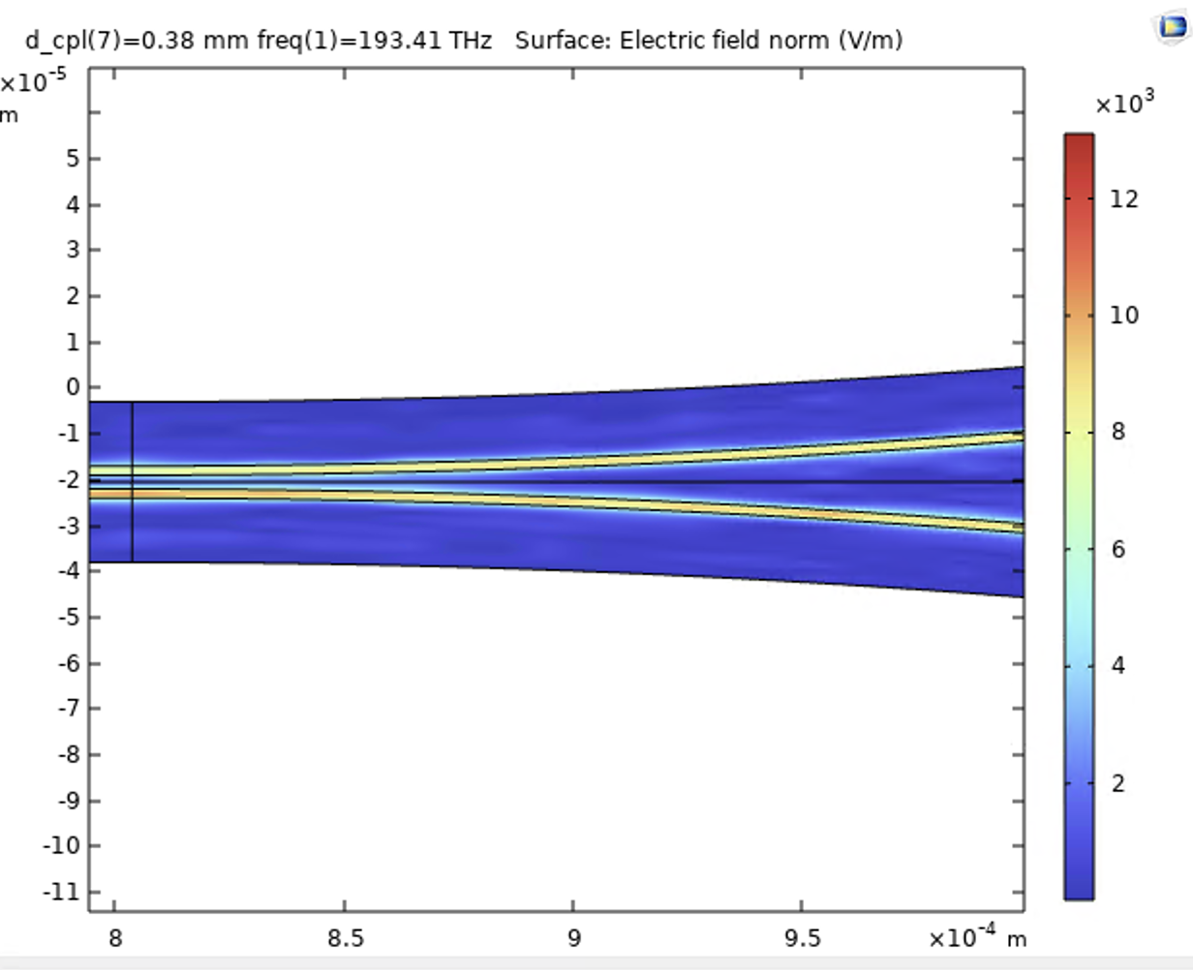
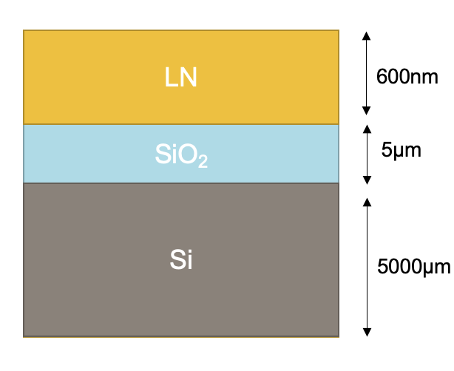
Background
Integrated Quantum Photonics
Photonics for Quantum Computation on Chip: a scalable way to achieve quantum computing at room temperature, which integrates with communication systems
Lithium Niobate on Insulator (LNOI)
The material combines the electro-optical and nonlinear-optical properties of LiNbO₃ with the benefits of thin film technology. It exhibits Pockels effect - refractive index changes linearly with the applied electric field.
LNOI is a unique and relatively new material that hasn’t had a lot of research dedicated to it yet.
Goal of the project: create a Quantum Gate in LNOI and prove its quantum properties
Notes:
The banner on subsequent slides should contain your name, project title and affiliation. You need to change this information in the “Slide Master” (View -> Slide Master). The total number of slides needs to be changed in the “Slide Master” too.

Slide 3
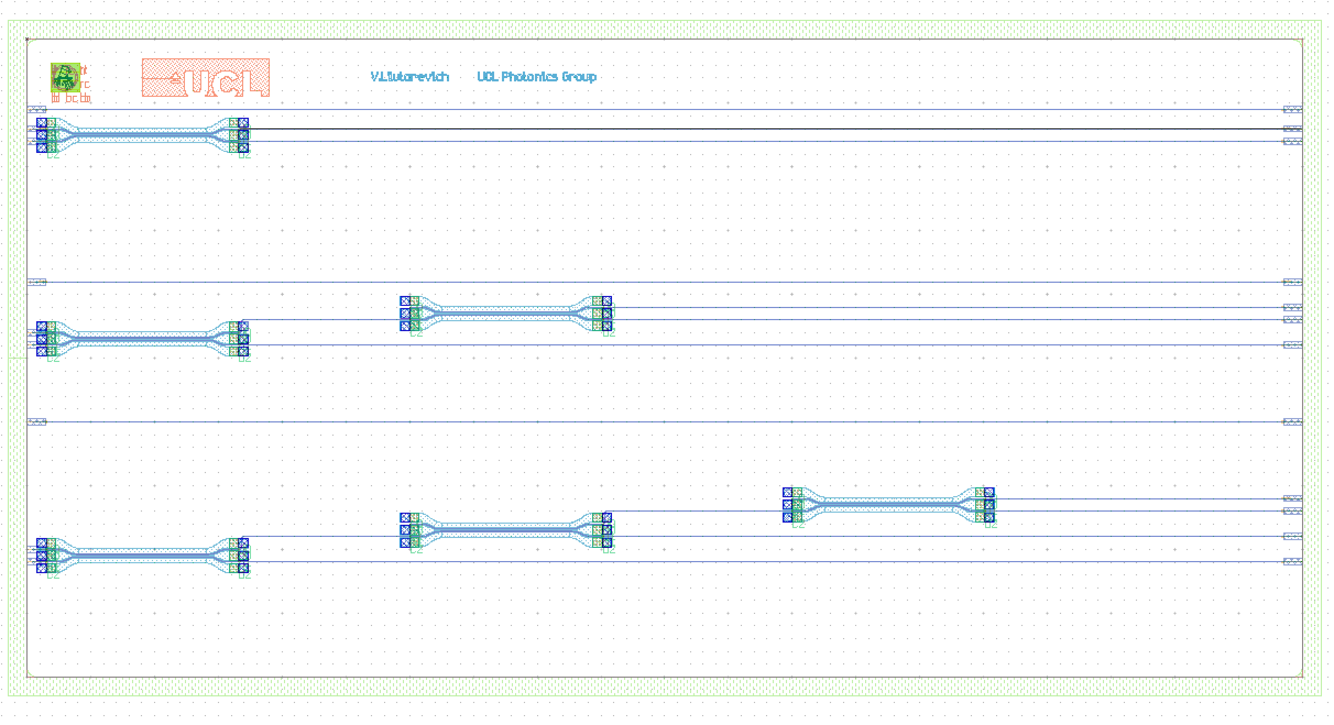
Photonic Integrated Circuit (PIC) design
Mach Zehnder Interferometer
The design is based on Mach-Zehnder interferometers.
This optical device makes it possible to manipulate the phase of the photons passing through the device.
Each Mach Zehnder has a gold contact attached to one of the branches to apply a voltage to change the phase of the MZI branch.

Slide 4
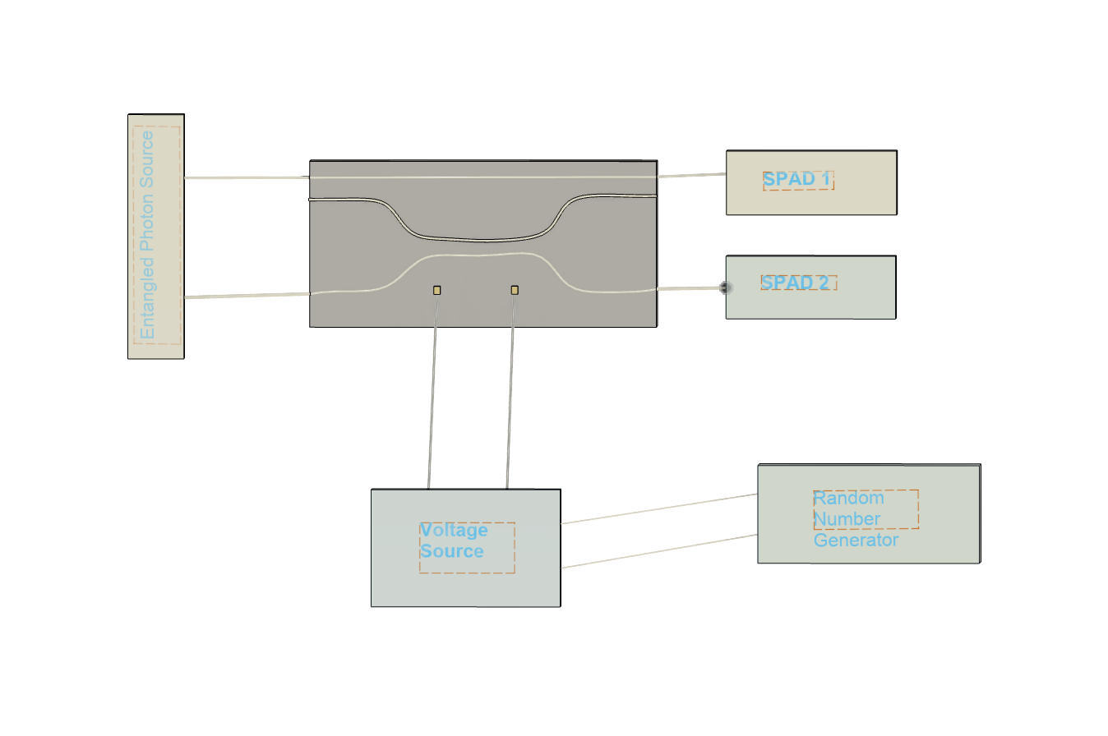
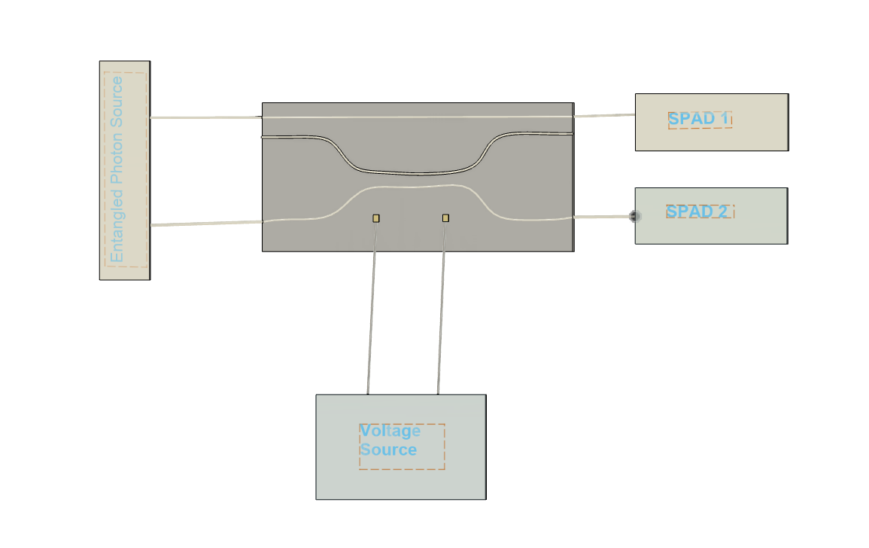
Not previously done in literature
Overall experiment
30km
Bell test
Entanglement a key properties of Quantum Systems.
It describes a connection between two particles in which one instantly influences another, regardless of the distance between them.
A Bell test experimentally checks quantum entanglement, testing Bell inequalities to distinguish between local hidden variables and quantum mechanics, confirming nonlocal correlations.
Superposition experiment
Superposition is a property of quantum systems that allows the system to be in multiple states at the same time.
The state of the system is not known until the measurement takes place.
Before measurement, the quantum system is in all possible states simultaneously with probabilities determined by the coefficients on the wavefunction.

Slide 5
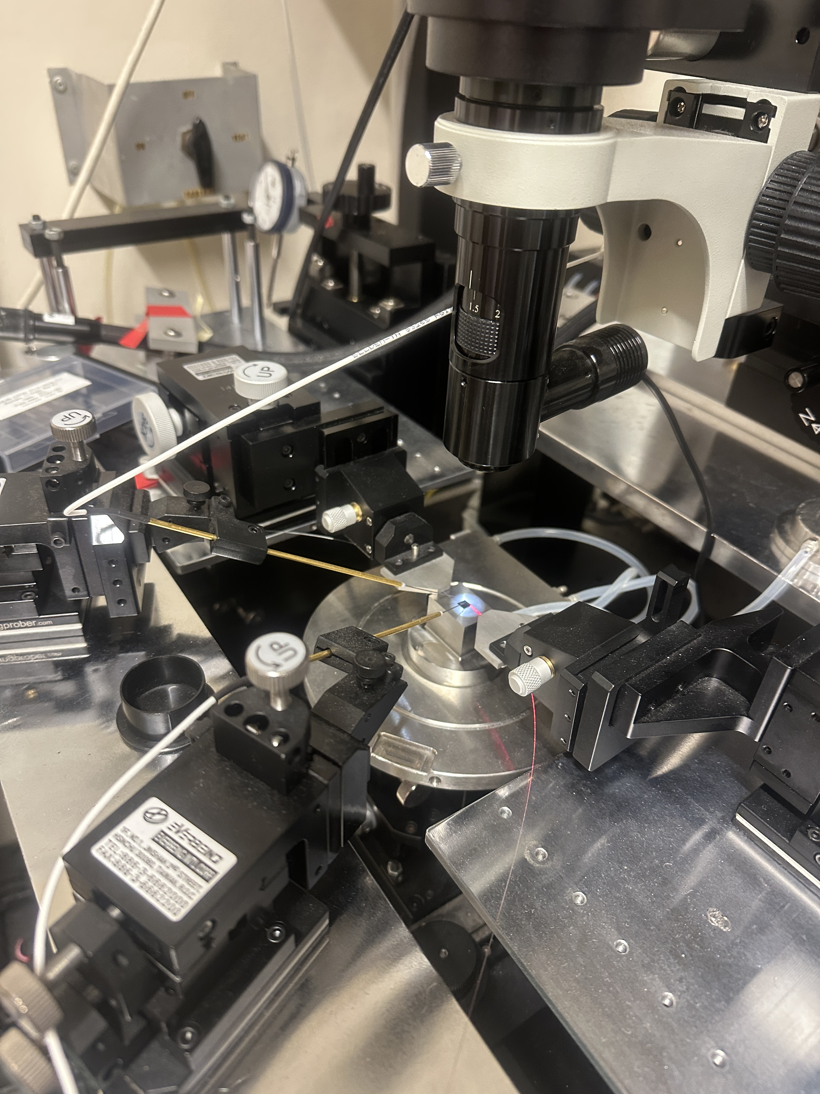
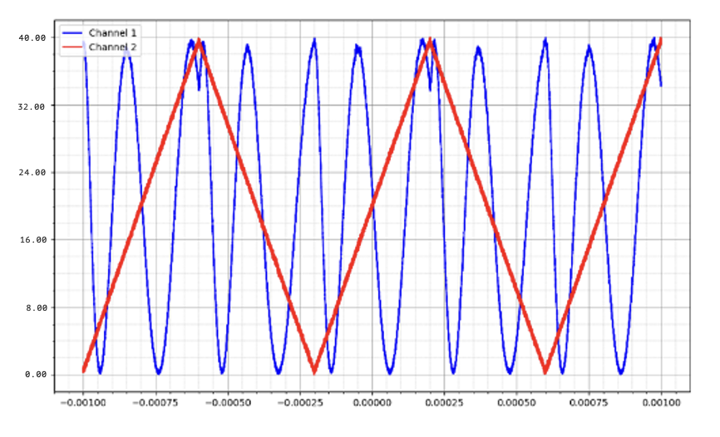
Phase-Voltage relationship
Using the chip, we can apply voltage to change the phase difference between the two branches. Different phase differences turn the MZI into different Quantum Gates.
This experiment helps determine what voltage would lead to which phase difference, and hence – which gate operation.
V_{π}=16.67 V
Voltage, V
Time, ms

Slide 6
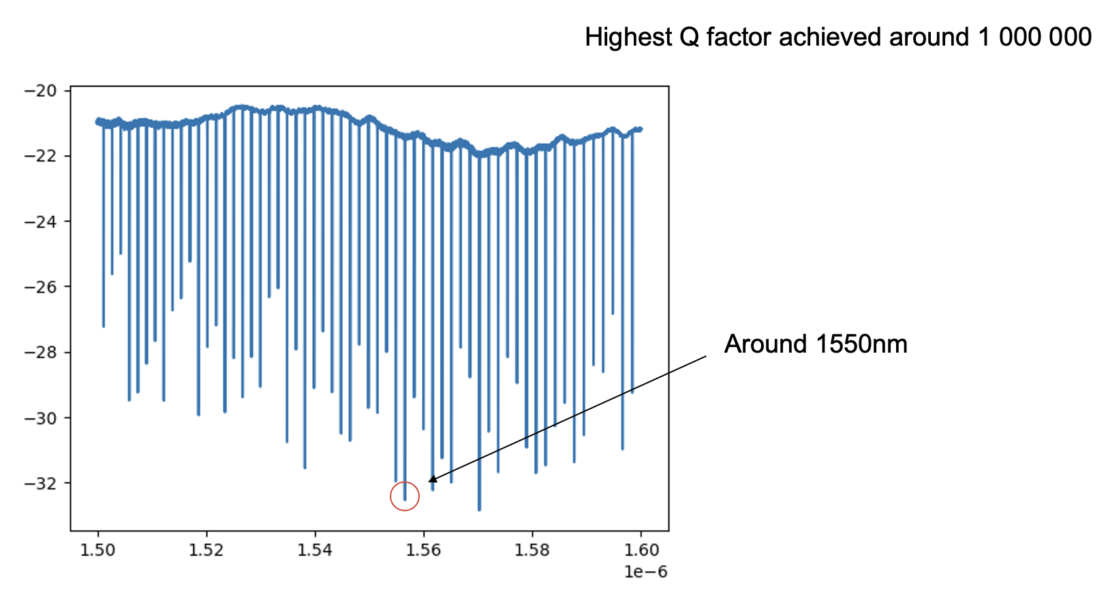
Single Photon Source
Four-Wave Mixing is a nonlinear optical effect that occurs when four waves interact in a nonlinear medium.
We can leverage this to generate a pair of entangled photons.
Here are the results of an experiment on a Ring Resonator circuit to use Four Wave Mixing in entangled photon generation.
The purpose of the experiment was to determine the Q-factor of the device.
High Q-factor means a higher probability to generate a single photon of the desired frequency (1550 nm in this case).
Q-factor (dBm)
Wavelength (m)

Slide 7
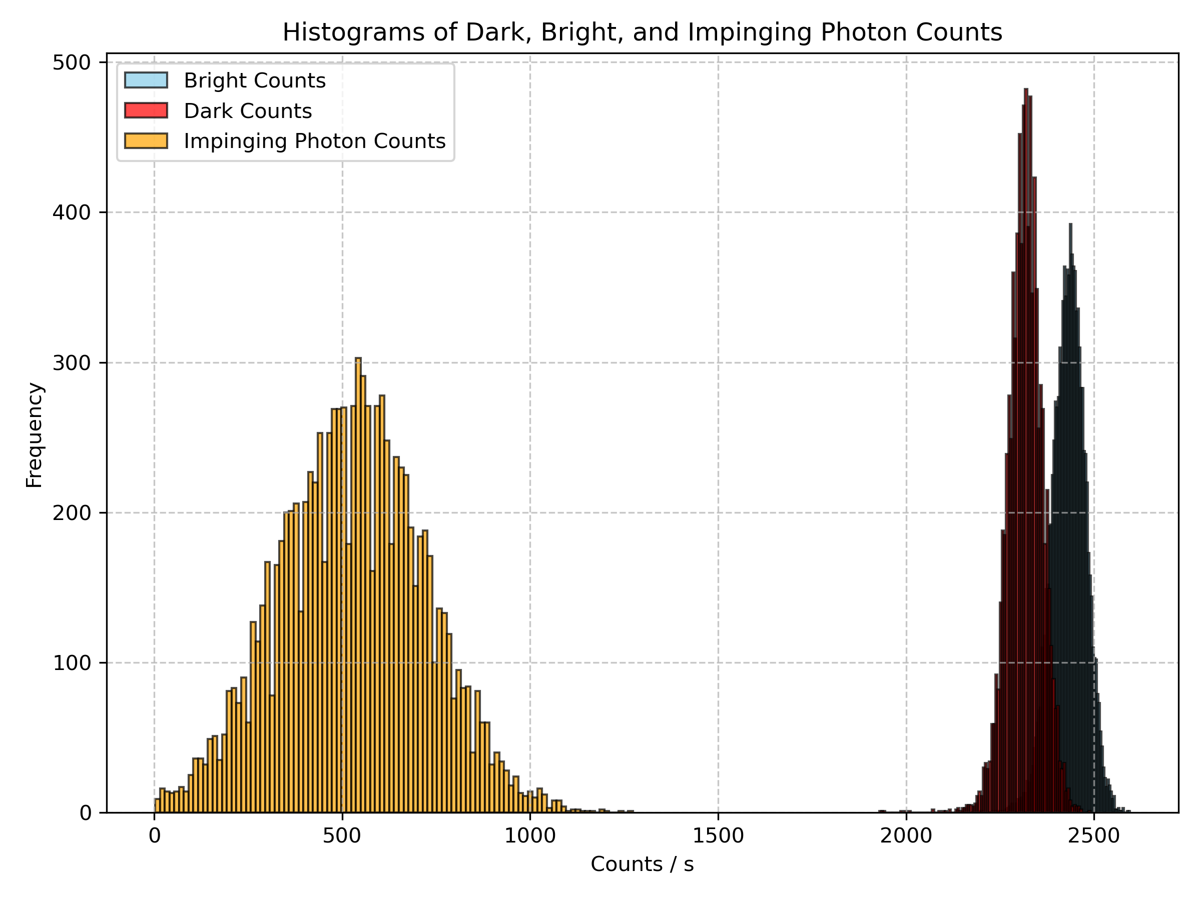
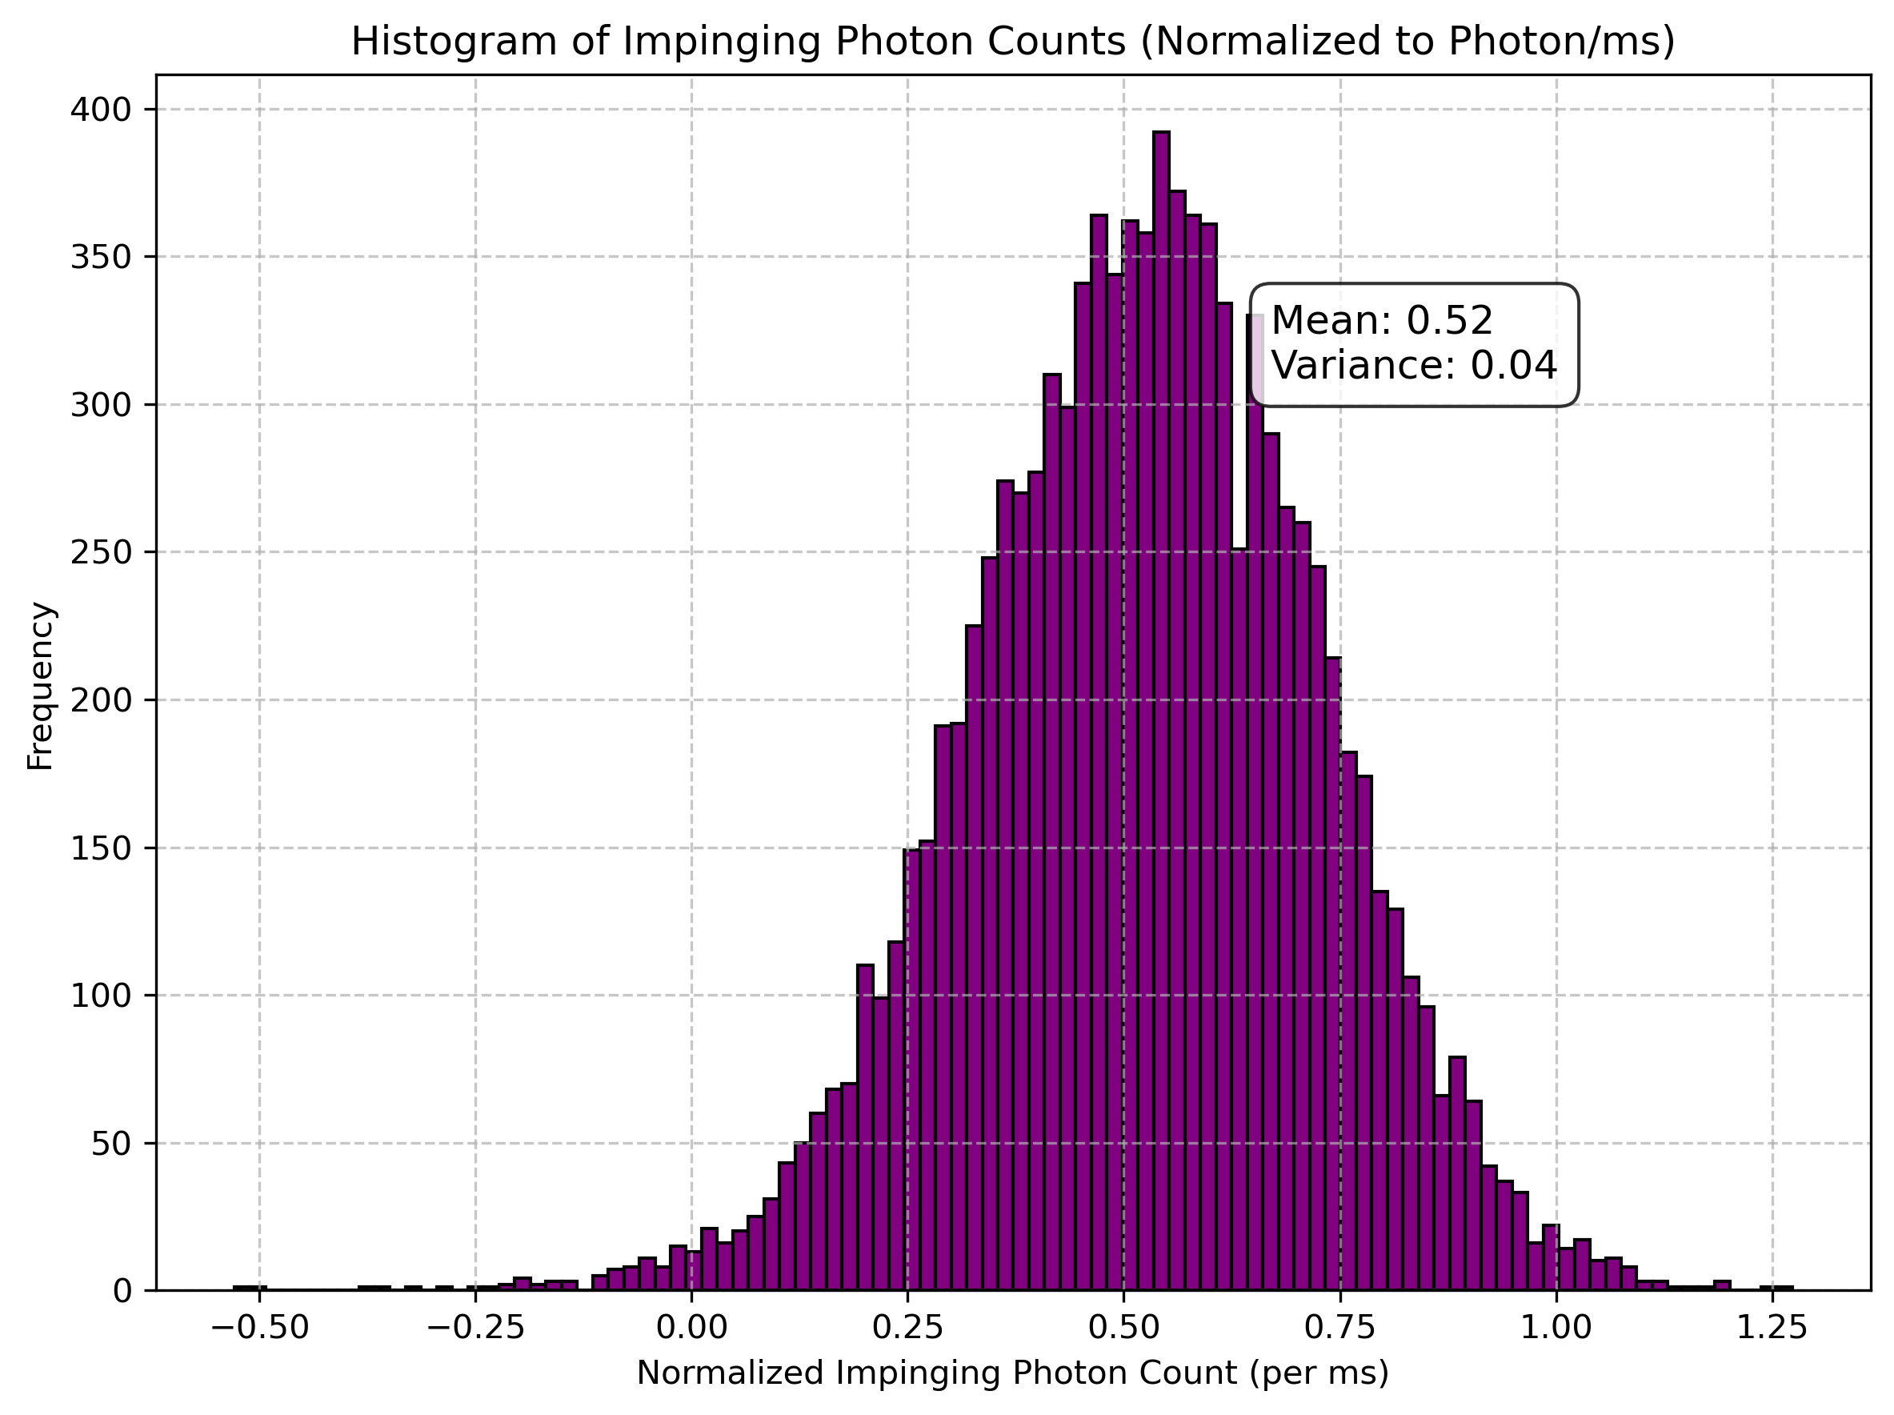
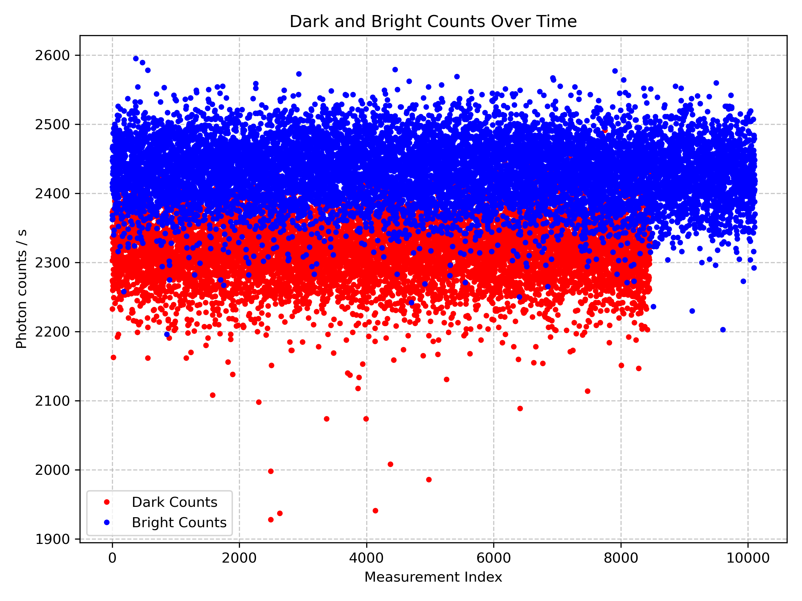
Single Photon Detector
The goal of characterizing the Single Photons Avalanche Detector (SPAD) is to determine the expected number of photons that can be measured per millisecond.
3. By analyzing the statistics of impinging photons and normalizing the data, get the number of photons detected per millisecond.
1. Measuring the number of photons registered by the detector in dark and bright conditions
2. Producing histograms of the counts of different types of photons. We are interested in impinging photons.

